Slide 1

HAP774 – AI IN HEALTHCARE
Taught by
Janusz Wojtusiak, PhD
LAKSHMI INDIRA KUPPA
Masters in Health Informatics
George Mason University

Slide 2
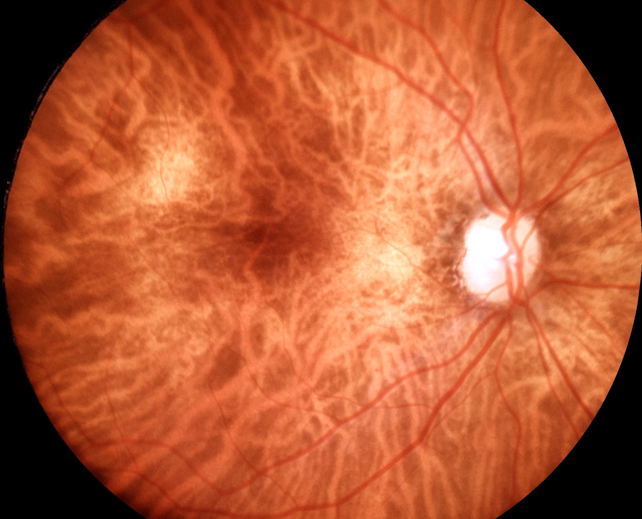
Detecting Diabetic Retinopathy with InceptionV3 CNN
The primary aim of this project is to classify retinal images into the presence or absence of Diabetic Retinopathy (DR) using the InceptionV3 Convolutional Neural Network (CNN) architecture.

Slide 3
DATASET DESCRIPTION
The dataset comprises 5164 retinal fundus images from 1291 diabetic patients. It includes a comma-delimited metadata file (labels_mbrset.csv) with detailed patient-level information and associated image labels. The key variables include patient demographics (age, sex), clinical characteristics (diabetes duration, insulin use, hypertension, etc.), and image-level diagnoses, such as International Clinical Diabetic Retinopathy (ICDR) scores ranging from no retinopathy to proliferative DR, as well as the presence of macular edema.
Patient-level data covers factors like age, sex, insulin use, and complications such as nephropathy and neuropathy.
Image-level data categorizes images based on DR severity and the presence of macular edema.
The dataset provides a foundation for machine learning models aimed at detecting diabetic retinopathy and macular edema. This dataset offers valuable insights into both patient-level risk factors and image-based diagnoses, making it ideal for clinical research and AI applications in retinal disease detection.

Slide 4
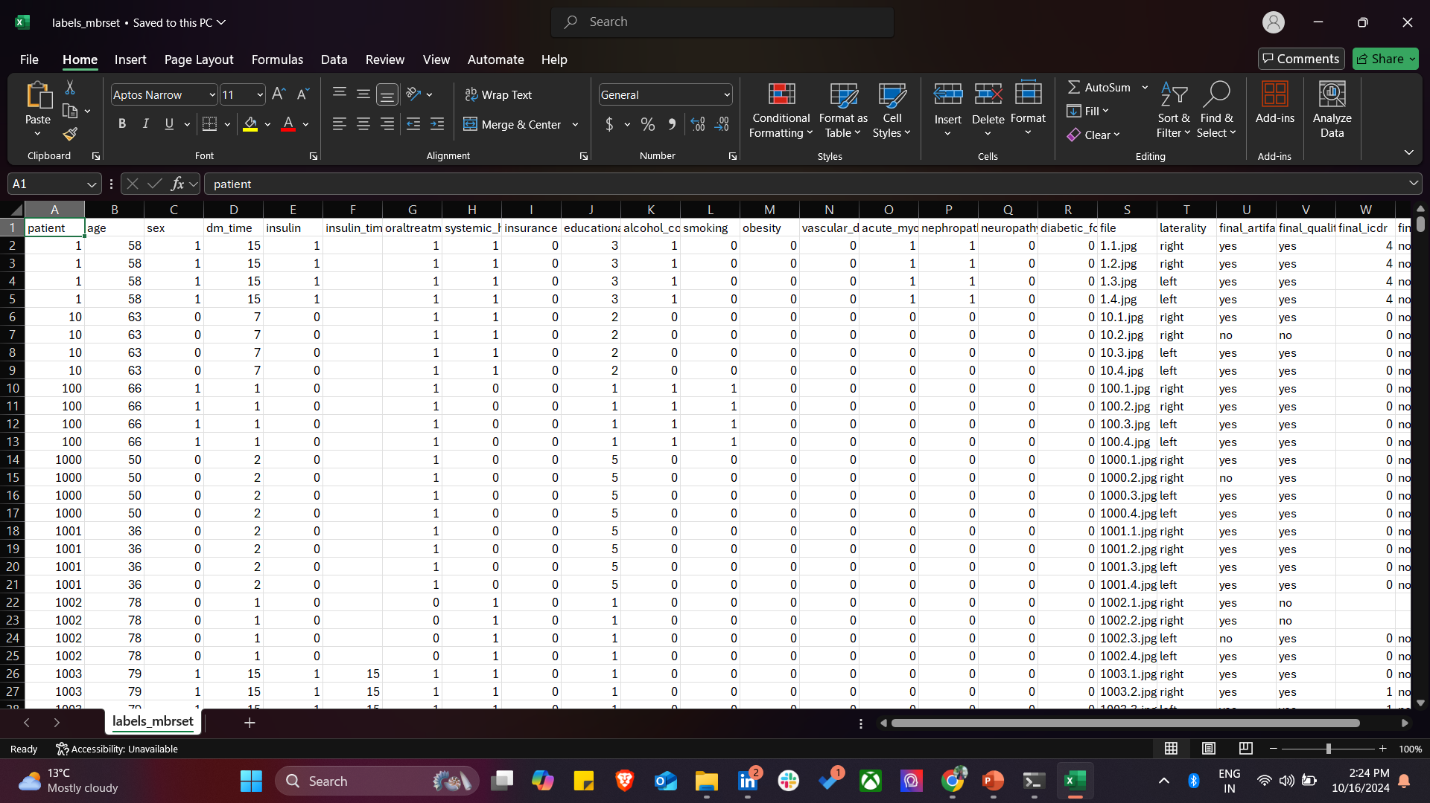
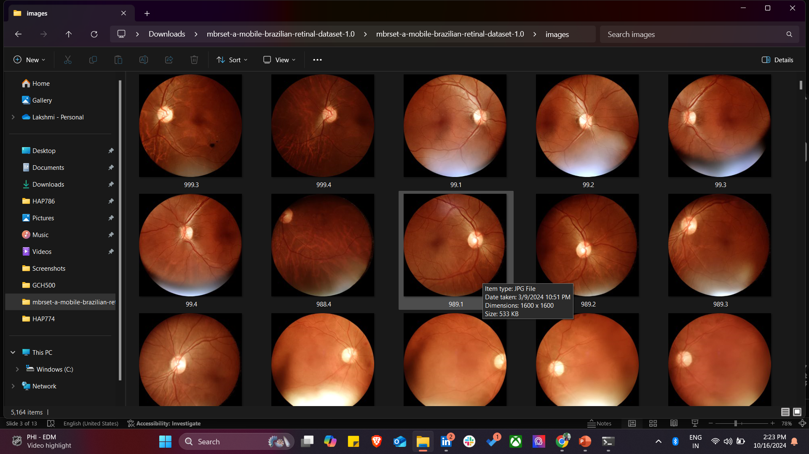
labels_mbrset.csv
Images file

Slide 5
High class imbalance!!
Class | Count | Description
0 | 3750 | Normal: No abnormalities
1 | 272 | Mild non-proliferative DR: Microaneurysms only
2 | 568 | Moderate non-proliferative DR: More than microaneurysms but less than severe NPDR
3 | 82 | Severe non-proliferative DR: Signs of severe NPDR
4 | 212 | Proliferative DR: Neovascularization or hemorrhages

Slide 6
Why Inception V3??
InceptionV3 is an ideal choice for diabetic retinopathy classification due to its efficient architecture and strong feature extraction capabilities. It uses Inception modules that allow the model to capture visual information at multiple scales, making it particularly effective for medical image analysis, where details like microaneurysms and hemorrhages vary in size. Compared to other models, InceptionV3 strikes a good balance between accuracy and computational efficiency, which is crucial when working with high-resolution medical images. Pre-trained on large-scale datasets like ImageNet, it provides a solid foundation for transfer learning, enabling it to quickly adapt to specific tasks like diabetic retinopathy classification with fewer training resources. Additionally, InceptionV3’s relatively lower parameter count compared to models like ResNet or DenseNet makes it a faster, more efficient model without compromising performance, thus making it a well-suited choice for this medical classification task.

Slide 7
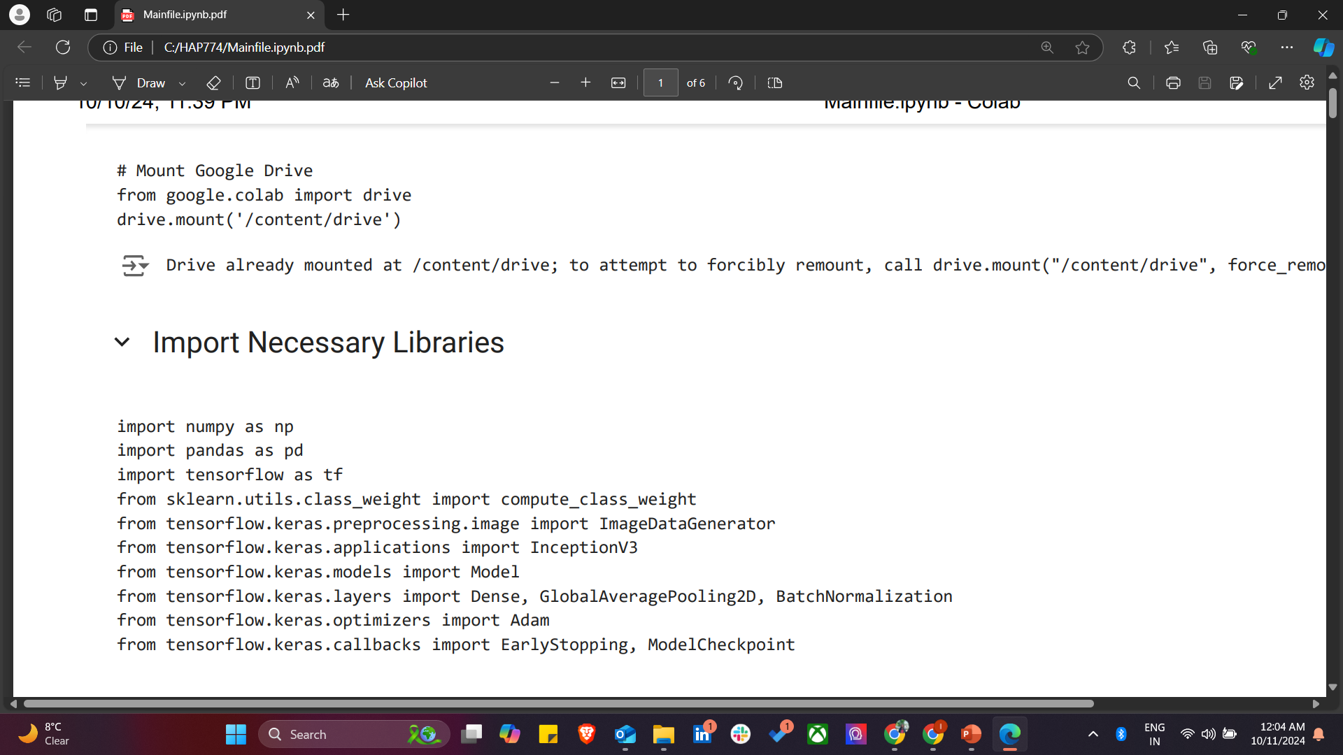
Necessary libraries are loaded for the diabetic retinopathy detection. NumPy and Pandas for data processing, and TensorFlow for building and training the deep learning model. The ImageDataGenerator is used to augment and preprocess the images, while InceptionV3 serves as the base pre-trained model. Additionally, EarlyStopping and ModelCheckpoint are used to monitor training, ensuring the best model is saved and preventing overfitting.

Slide 8
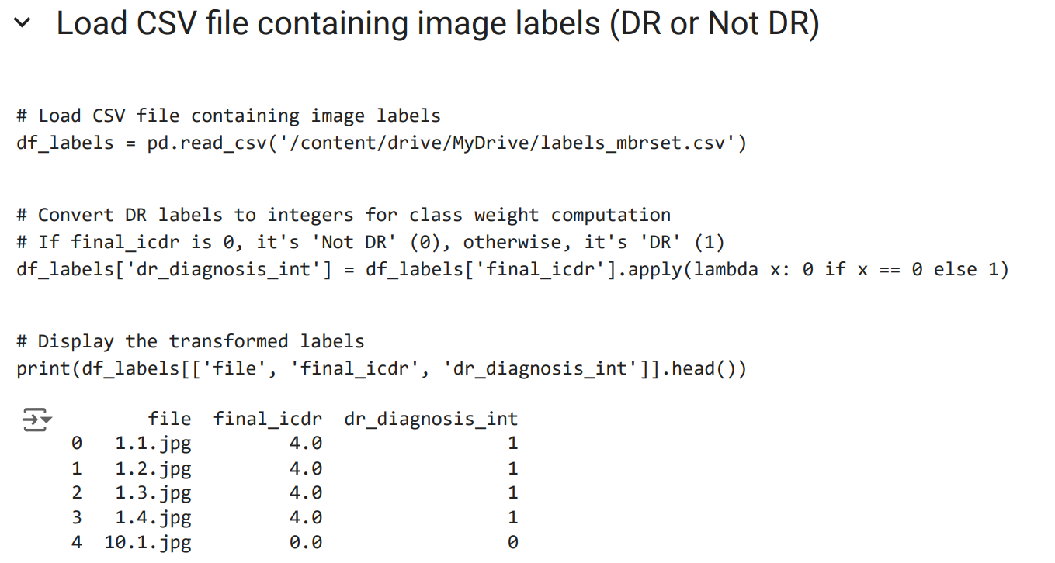
The CSV file containing image labels, such as the image file name and its corresponding diabetic retinopathy (DR) diagnosis, is loaded. The ICDR score is converted into binary labels, where 0 represents "Not DR" and any other value represents "DR". This transformation prepares the data for model training and class weight computation, helping to balance the dataset for the classification task. The transformed labels are displayed for verification.

Slide 9
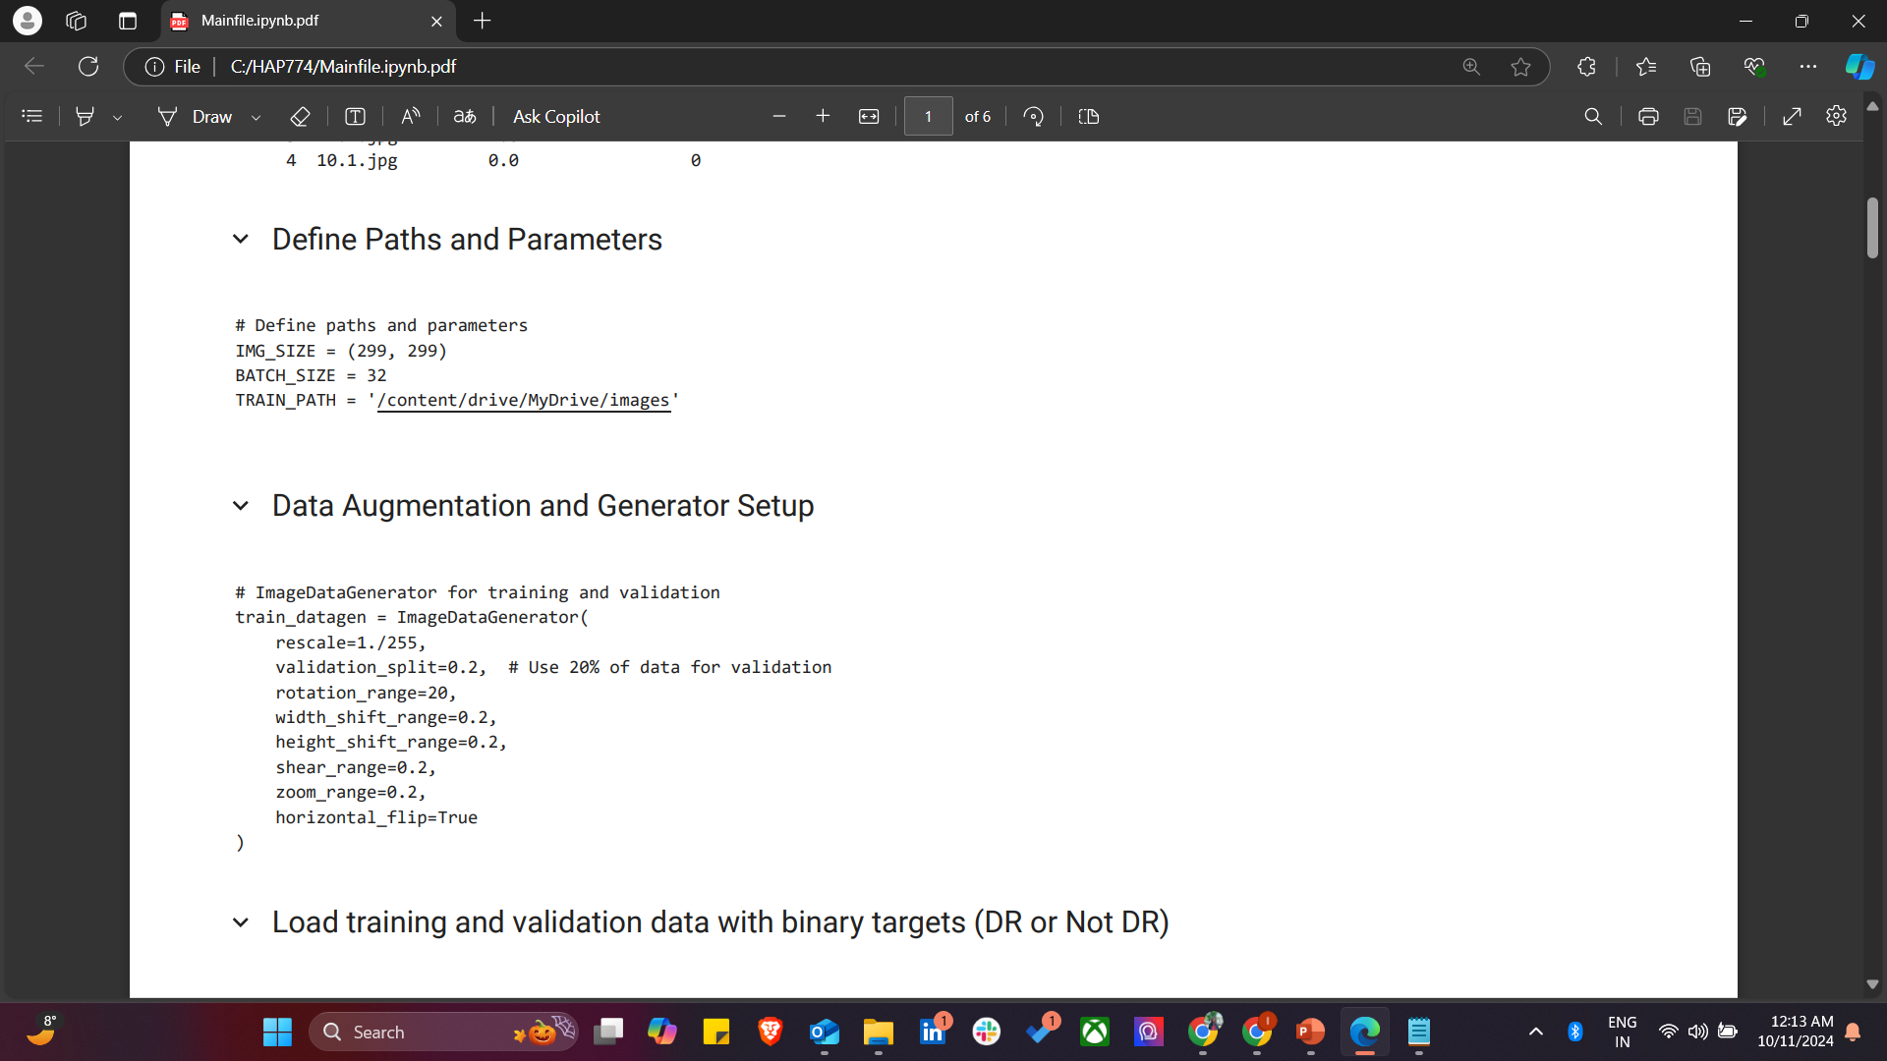
In this section, key paths and parameters for image processing are defined, including the image size and batch size for training. The ImageDataGenerator is used to apply data augmentation techniques such as rotation, zooming, and flipping, which helps to enhance the model's robustness. A validation split is set to use 20% of the data for validating the model's performance during training, ensuring a well-rounded evaluation of the model's accuracy and loss.

Slide 10
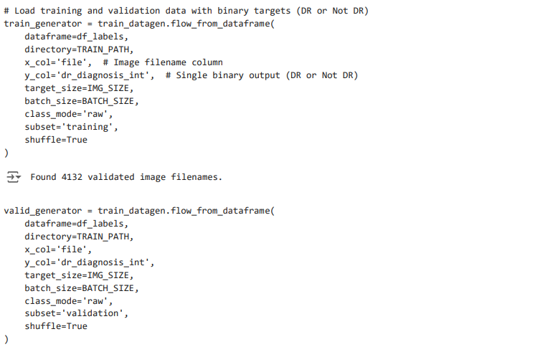
In this section, the code initializes the loading of training and validation data. Using the ImageDataGenerator function, it reads the images from the dataset and assigns binary labels (DR or Not DR) based on the corresponding metadata. The training data is split into training and validation subsets, with 80% of the data used for training and 20% for validation. The flow_from_dataframe function is employed to read image filenames and their associated labels, shuffle them, and prepare them for the model to train on.

Slide 11
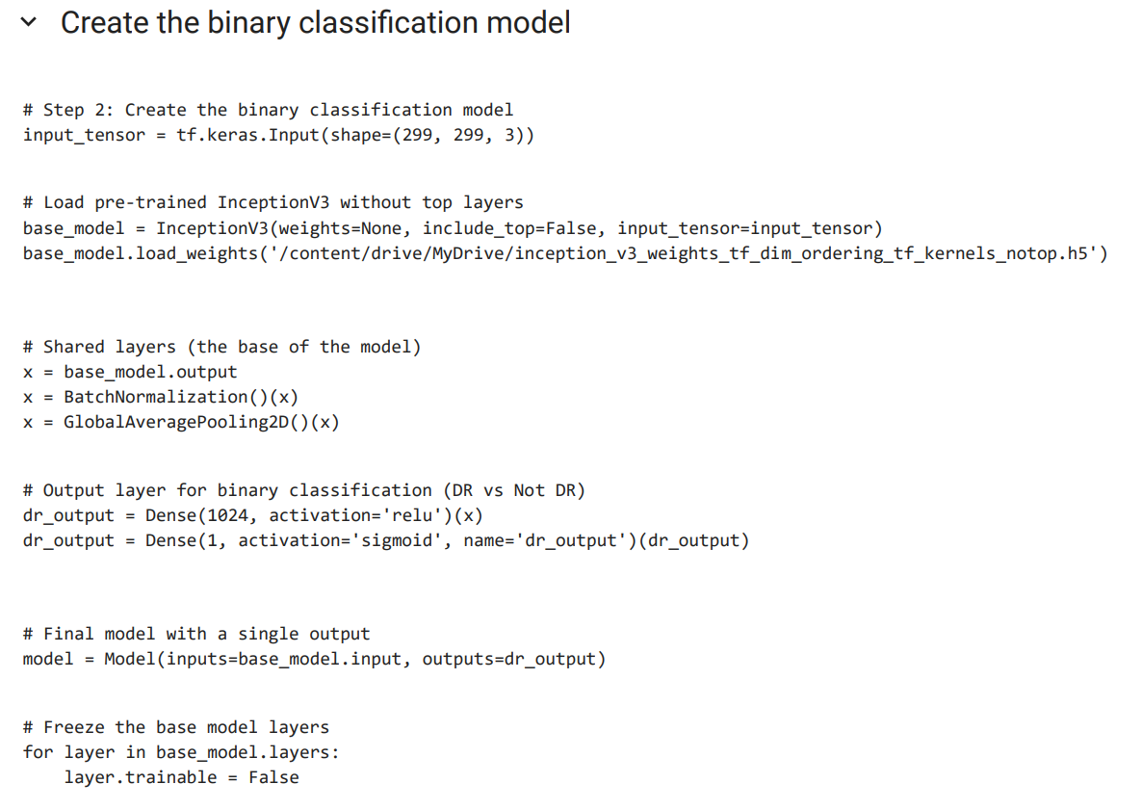
In this section, we create the binary classification model using the InceptionV3 architecture as the base model. The pre-trained weights of the model are loaded without the top layers, which allows us to customize the output. After adding shared layers like BatchNormalization and GlobalAveragePooling, we define the final output layer for binary classification (DR vs Not DR) using the sigmoid activation function. The base model's layers are frozen to retain the pre-trained features, and only the custom layers will be trained for the classification task. Then I handled class imbalance by computing class weights and compiled the model , optimized it with Adam

Slide 12
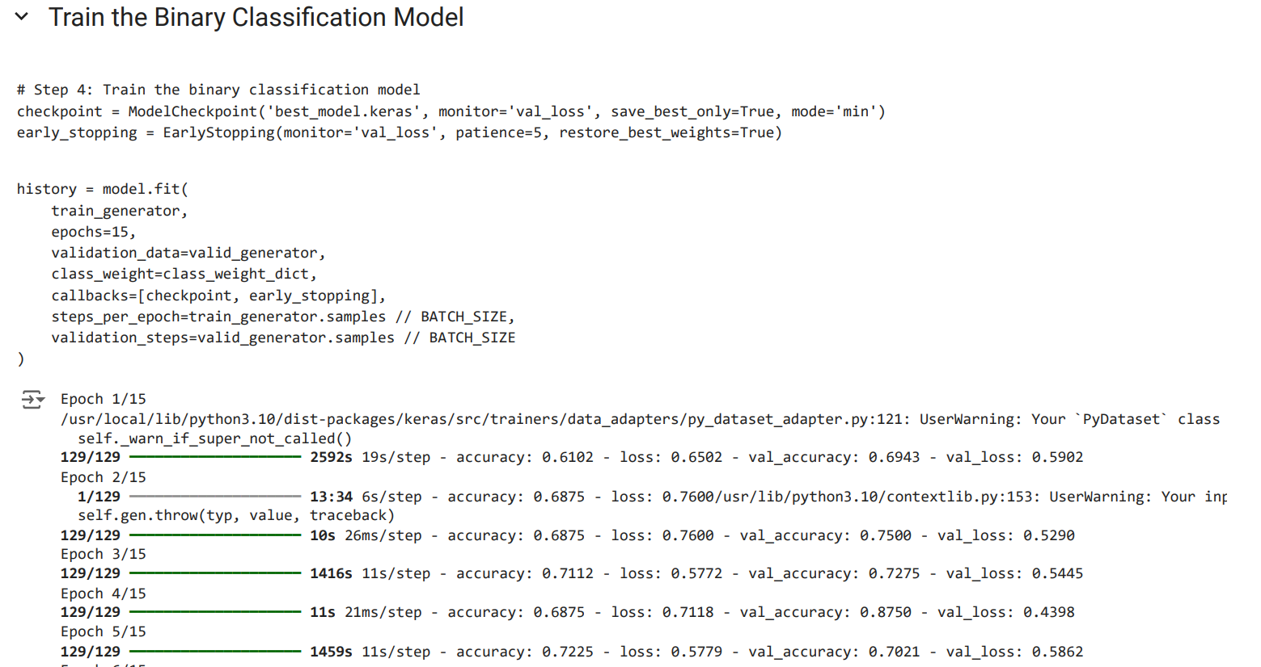

Slide 13
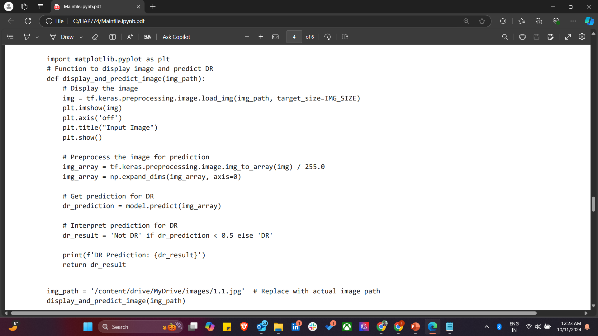
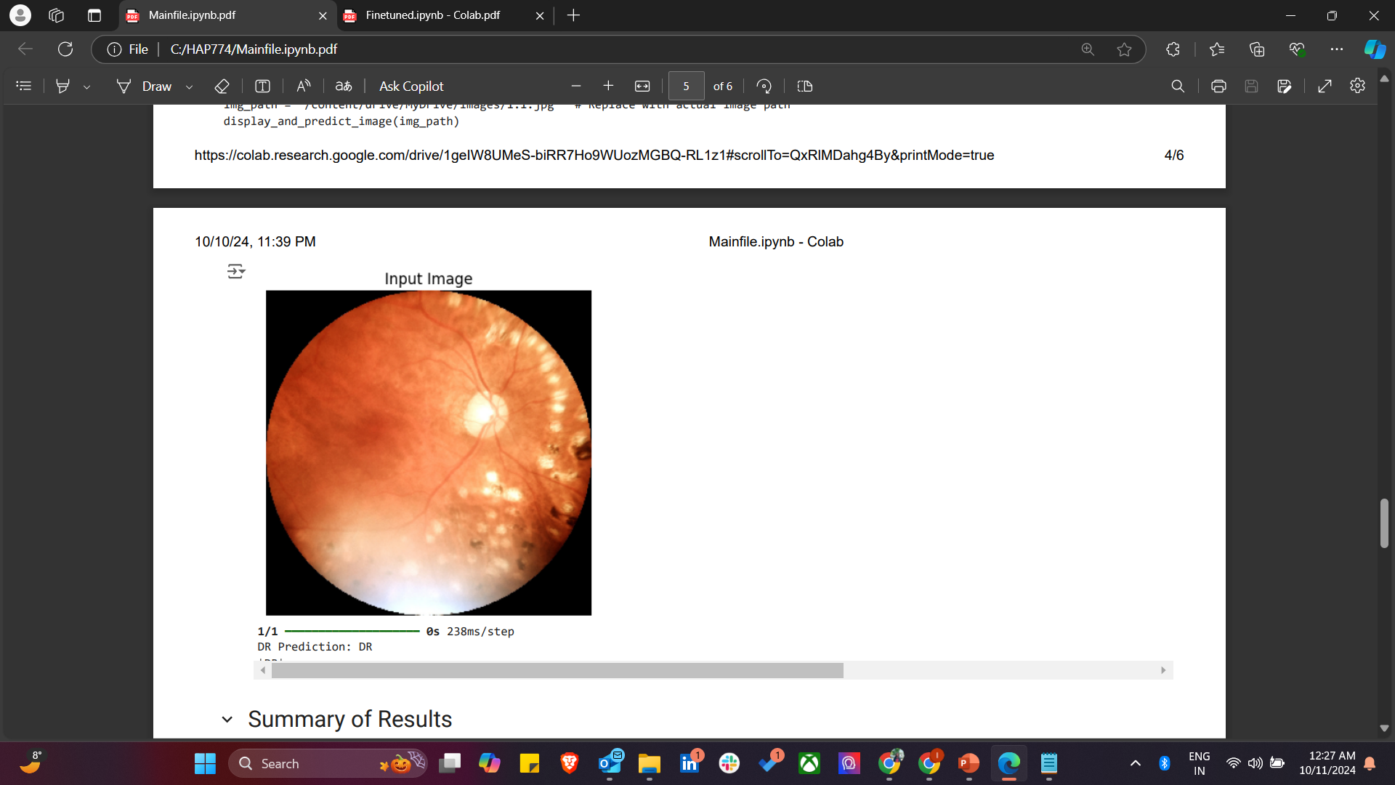

Slide 14
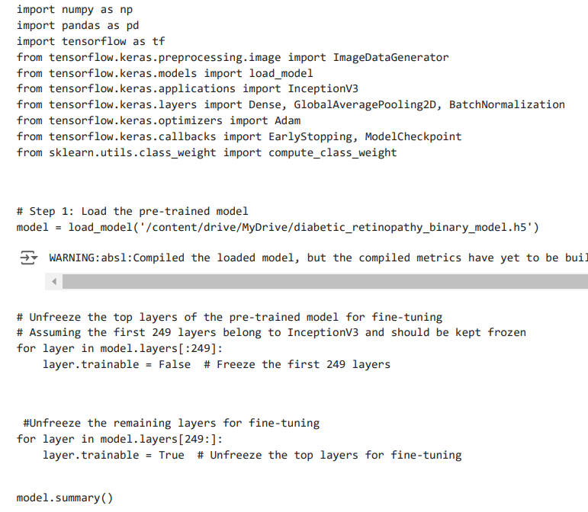
Fine tuned!

Slide 15
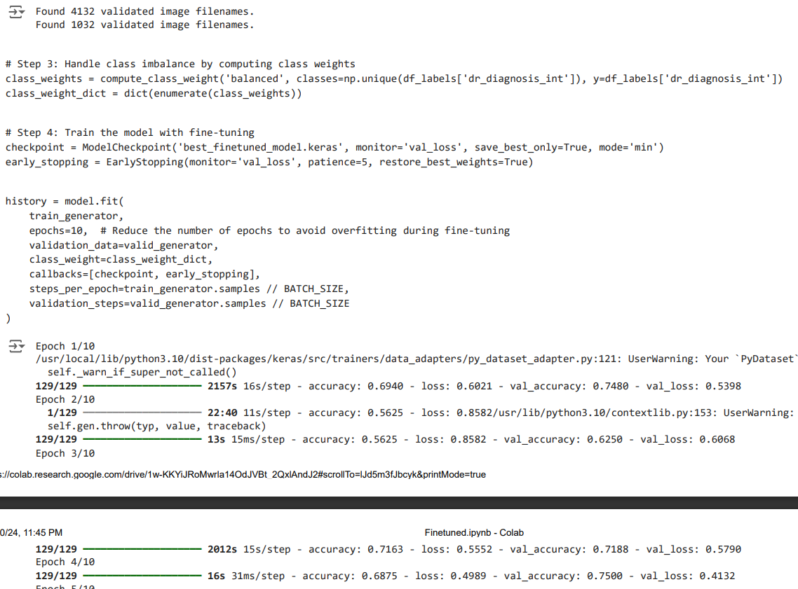

Slide 16
Metric | First | Second | Explanation
Training Accuracy | 75.48% | 71.61% | The training accuracy before fine-tuning was higher (75.48%) but showed signs of overfitting. After fine-tuning, it was slightly lower (71.61%) but better balanced with the validation accuracy, indicating better generalization.
Validation Accuracy | 66.60% | 71.78% | Before fine-tuning, the validation accuracy ended at 66.60%, lower than the training accuracy. After fine-tuning, it improved to 71.78%, showing the model performed better on unseen validation data.
Training Loss | 0.5296 | 0.4905 | The training loss before fine-tuning was 0.5296. After fine-tuning, the model learned more effectively, reducing the training loss to 0.4905.
Validation Loss | 0.597 | 0.5621 | Before fine-tuning, the validation loss was higher (0.5970) than the training loss, indicating overfitting. After fine-tuning, the validation loss decreased to 0.5621, reflecting better performance on unseen data.

Slide 17
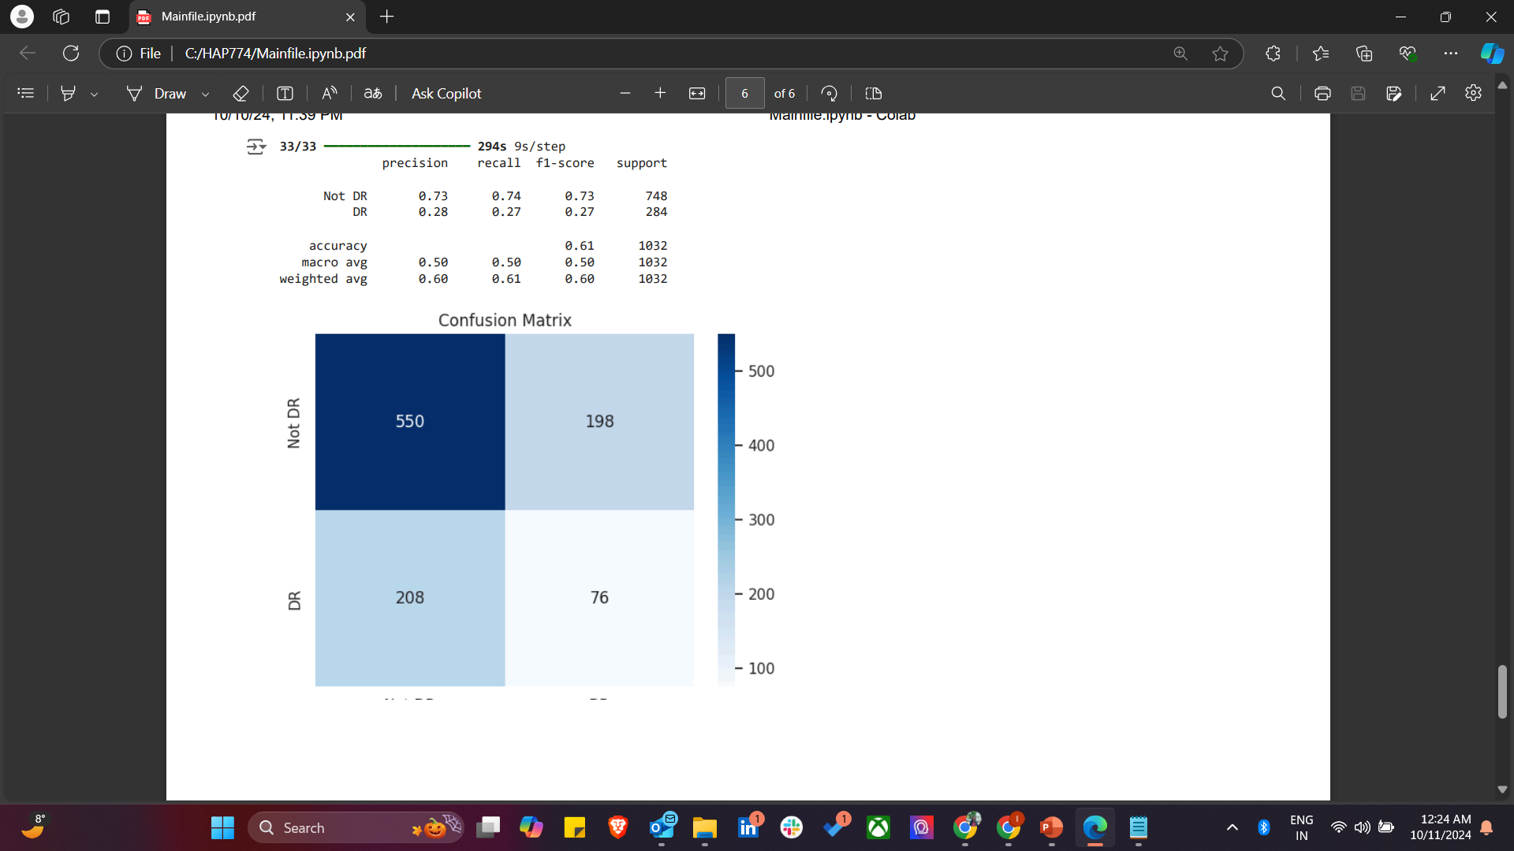
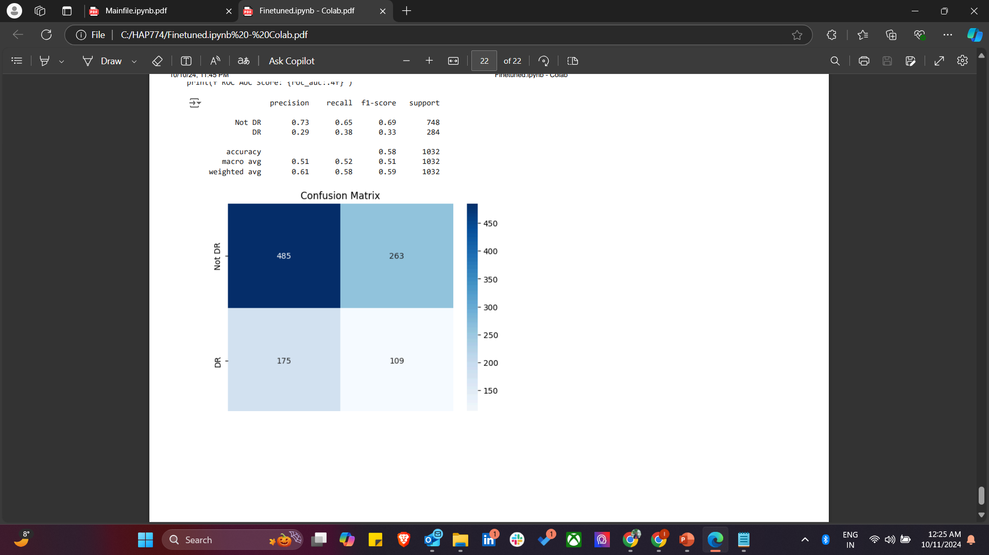
CONFUSION MATRIX
BEFORE
AFTER

Slide 18
PROBLEMS WITH THIS?!
Issue | Description | Solution
Class Imbalance | There are significantly more 'Not DR' images compared to 'DR' images, leading to bias in predictions. | Use class weighting, oversampling (SMOTE), undersampling, or data augmentation for the minority class.
Overfitting | The model shows signs of overfitting, performing well on training data but struggling to generalize to validation data. | Implement regularization (e.g., Dropout), use early stopping, fine-tune learning rates, or freeze more layers.
Limited Dataset Size | The dataset may be too small to fully train a complex model like InceptionV3, leading to poor generalization. | Apply data augmentation techniques, use transfer learning, or source pre-trained models on medical datasets.
Low Precision and Recall for DR Class | Low precision and recall values for the DR class indicate the model's struggle to identify diabetic retinopathy cases. | Use class weighting, experiment with thresholds, and consider different loss functions (e.g., focal loss) to improve precision and recall.

Slide 19
FUTURE CONSIDERATIONS I WANT TO MAKE -
1. Creating a Webpage for Image Prediction:
Develop a webpage using HTML and JavaScript for image uploads.
Use Flask or Django to load the model in the back-end and perform predictions.
Deploy the webpage on a platform like Heroku to make the prediction tool accessible online.
2.Testing Different Models for Accuracy Comparison:
Explore other pre-trained models like ResNet50, EfficientNet, and DenseNet for comparison.
Fine-tune these models and evaluate their accuracies using metrics like Confusion Matrix and AUC-ROC.
Compare the performance of these models to determine the most suitable one for diabetic retinopathy classification.

Slide 20
REFERENCES -
https://physionet.org/content/mbrset/1.0/
https://www.medrxiv.org/content/10.1101/2024.02.12.24302676v1.full#sec-31
https://www.kaggle.com/datasets/madmaxliu/inceptionv3/code
https://github.com/rmaphoh/RETFound_MAE
https://github.com/frankkramer-lab/riadd.aucmedi

